Slide 1
Decision Support Systems
Ömer Emre ASLAN
Yunus YILMAZ

Slide 2
Outline
A brief history of DSS
What is Decision Support System
Types of DSS
Architecture
Testing methods for DSS
Advantages and Disadvantages
Why DSS? / Using DSS
Examples

Slide 3
A brief history
Academic Researchers from many disciplines has been studying DSS for approximately 40 years.
According to Keen and Scott Morton (1978), the concept of decision support has evolved from two main areas of research:
the theoretical studies of organizational decision making done at the Carnegie Institute of Technology during the late 1950s and early 1960s,
the technical work on interactive computer systems, mainly carried out at the Massachusetts Institute of Technology in the 1960s.
It is considered that the concept of DSS became an area of research of its own in the middle of the 1970s, before gaining in intensity during the 1980s.

Slide 4
A brief history
In the middle and late 1980s, Executive Information Systems (EIS), group decision support systems (GDSS), and organizational decision support systems (ODSS) evolved from the single user and model-oriented DSS.
Beginning in about 1990, data warehousing and on-line analytical processing (OLAP) began broadening the realm of DSS.
As the turn of the millennium approached, new Web-based analytical applications were introduced.

Slide 5
Decision Support System
A Decision Support System (DSS) is an interactive computer-based system or subsystem intended to help decision makers use communications technologies
data, documents, knowledge and/or models to identify and solve problems, complete decision process tasks, and make decisions.
Decision Support System is a general term for any computer application that enhances a person or group’s ability to make decisions.
Also, Decision Support Systems refers to an academic field of research that involves designing and studying Decision Support Systems in their context of use.

Slide 6
A summary of commercial DSS system
A summary of commercial DSS system show seven types of DSS:
File Drawer Systems, that provide access to the data items.
Data Analysis systems, that support manipulation of data by computerized tools for a specific task.
Analysis Information systems, that provide access to a series of decision oriented databases and small models.
Accounting and financial models, that calculates the consequences of possible actions.
Representational model, that estimates the consequences of actions based on simulation models.
Optimization models, that provide guidelines for action by generating an optimal solution
Suggestion models, that perform the logical processing to a specific suggested decision for a task.

Slide 7
A Multidiscipline Study
It is clear that DSS belong to an environment with multidisciplinary foundations, including (but not exclusively):
Database research,
Artificial intelligence,
Human-computer interaction,
Simulation methods,
Software engineering, and
Telecommunications.

Slide 8
Types of Decision Support Systems
Using the mode of assistance as the criterion, Power (2002) differentiates five types for DSS:
communication-driven DSS,
data-driven DSS,
document-driven DSS,
knowledge-driven DSS, and
model-driven DSS.

Slide 9
Communication-driven DSS
A communication-driven DSS use network and comminication technologies to faciliate collaboartion on decision making. It supports more than one person working on a shared task.
examples include integrated tools like Microsoft's NetMeeting or Groove (Stanhope 2002), Video conferencing.
It is related to group decision support systems.

Slide 10
Data-driven (retrieving) DSS
Generally, Data­driven DSS are used by managers or product/service suppliers.
It is used to reach intended answers for an intended objective with querying to database.
Its usage has so simple functionality. Examples:
Accessing AMMIS data base for all maintenance Jan89-Jul94 for CH124
Accessing INTERPOL database for crimes by …….
Accessing border patrol database for all incidents in Sector ...

Slide 11
Document-driven DSS
A document-driven DSS uses storage and processing technologies to document retrieval and analysis.
It manages, retrieves and manipulates unstructured information in a variety of electronic formats.
Document database may include: Scanned documents, hypertext documents, images, sound and video.
A search engine is a primary tool associated with document drivel DSS.

Slide 12
Knowledge-driven DSS
A knowledge-driven DSS provides specialized problem solving expertise stored as facts, rules, procedures, or in similar structures.
It suggest or recommend actions to managers.
Its main usage reason is that it provides the managers management advice and select the suitable products and services.
Its systems can be server, web platform and software running computer.

Slide 13
Model-driven DSS
This DSS support the analyzing decisions and helping to choose different decision options.
This DSS’s usage purposes depends on the users.
It is suitable for model setting up, scheduling and decision analyses.
It can be used with software in a computer, client/server systems and web services.
Other examples:
A statistical forecasting model
An optimum routing model

Slide 14
Model and data-retrieving DSS
Examples:
Collect weather observations at all stations and forecast tomorrow’s weather
Collect data on all civilian casualties to predict casualties over the next month

Slide 15
Architecture
Three fundamental components of DSS:
the database management system (DBMS),
the model management system (MBMS), and
the dialog generation and management system (DGMS).
the Data Management Component stores information (which can be further subdivided into that derived from an organization's traditional data repositories, from external sources such as the Internet, or from the personal insights and experiences of individual users);
the Model Management Component handles representations of events, facts, or situations (using various kinds of models, two examples being optimization models and goal-seeking models); and
the User Interface Management Component is of course the component that allows a user to interact with the system.

Slide 16
A Detailed Architecture
Even though different authors identify different components in a DSS, academics and practitioners have come up with a generalized architecture made of six distinct parts:
the data management system,
the model management system,
the knowledge engine,
The user interface,
the DSS architecture and network, and
the user(s)

Slide 17
Typical Architecture
TPS: transaction processing system
MODEL: representation of a problem
OLAP: on-line analytical processing
USER INTERFACE: how user enters problem & receives answers
DSS DATABASE: current data from applications or groups
DATA MINING: technology for finding relationships in large data bases for prediction
DSS DATA
EXTERNAL
TPS
BASE
DATA
DSS SOFTWARE SYSTEM
USER
MODELS
INTERFACE
OLAP
TOOLS
DATA MINING
TOOLS
USER

Slide 18
DSS Model base
Model base
A software component that consists of models used in computational and analytical routines that mathematically express relations among variables
Examples:
Linear programming models,
Multiple regression forecasting models
Capital budgeting present value models

Slide 19
Testing Methods for Decision Support Systems
Static Method
Does not need to use DSS
Review of the DSS’ knowledge base
Control logical or semantic errors in knowledge base
Called as Verification
it asks the test that are you building the system right?
Dynamic Method
Depends on using DSS
Solve some test cases
Considered the DSS output as erroneous or not
Called as Validation
it asks the test are you building the right system?

Slide 20
Advantages of DSS
Improves performance and effectiveness of the user
Allows for faster decision-making
Reduces the time taken to solve problems
These combine to save money!
Has been seen to improve collaboration and communication within groups
Reduces training times because the experience of experts is available within the programs algorithms
Provides more evidence in support of a decision
May increase decision-maker satisfaction
Providing different perspectives to a situation
Helps automate various business systems
Increase productivity

Slide 21
Disadvantages of DSS
Too much emphasis/control given to the machines.
May reduce skill in staff because they become dependent on the computers
Reduction in efficiency because of information overload
Shift of responsibility - easy to blame computer!
False sense of being objective - humans still feed information in and decide how exactly to process it.

Slide 22
Why DSS?
Increasing complexity of decisions
Technology
Information:
“Data, data everywhere, and not the time to think!”
Number and complexity of options
Pace of change
Increasing availability of computerized support
Inexpensive high-powered computing
Better software
More efficient software development process
Increasing usability of computers

Slide 23
Using DSS
What-if Analysis
End user makes changes to variables, or relationships among variables, and observes the resulting changes in the values of other variables
Sensitivity Analysis
Value of only one variable is changed repeatedly and the resulting changes in other variables are observed
Goal-Seeking
Set a target value for a variable and then repeatedly change other variables until the target value is achieved
Optimization
Goal is to find the optimum value for one or more target variables given certain constraints
One or more other variables are changed repeatedly until the best values for the target variables are discovered

Slide 24
EXAMPLES

Slide 25
Diet Problem
Given a set of foods, along with the nutrient information for each food and the cost per serving of each food, the objective of the diet problem is to select the number of servings of each food to purchase (and consume) so as to minimize the cost of the food while meeting the specified nutritional requirements. Typically, the nutritional requirements are expressed as a minimum and a maximum allowable level for each nutritional component. Other constraints such a minimum and/or maximum number of servings may be included to improve the quality of the menu.
Consider the following simple example (from The Diet Problem: A WWW-based Interactive Case Study in Linear Programming). Suppose there are three foods available, corn, milk, and bread, and there are restrictions on the number of calories (between 2000 and 2250) and the amount of Vitamin A (between 5000 and 50,000). The first table lists, for each food, the cost per serving, the amount of Vitamin A per serving, and the number of calories per serving. Suppose that the maximum number of servings is 10.
Food | Cost per serving | Vitamin A | Calories
Corn | $0.18 | 107 | 72
2% Milk | $0.23 | 500 | 121
Wheat Bread | $0.05 | 0 | 65

Slide 26
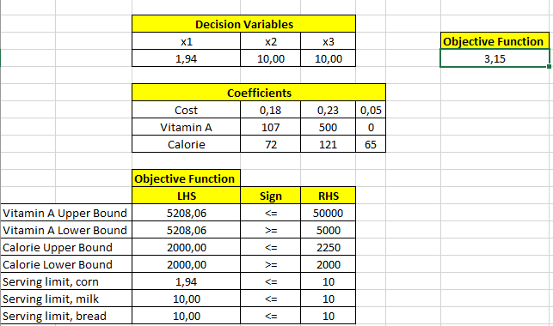
Solver Problem

Slide 27
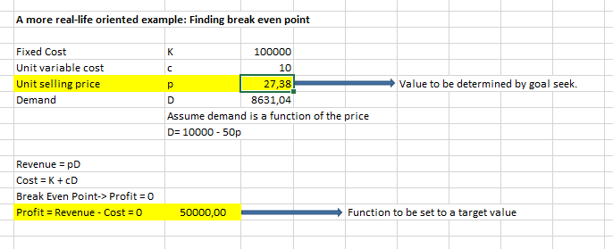
Goal seek example

Slide 28
An Automated and Intelligent Medical Decision Support System for Brain MRI Scans Classification
To classify MRI Imagesets as normal or abnormal
Used ;
fast discrete wavelet transform (DWT),
Principal component analysis (PCA),
Least squares support vector machine (LS­SVM).
To classify MRI image set, ‘Harvard Medical School’ and ‘Open Access Series of Imaging Studies (OASIS)’
2­D fast DWT which is image processing function to specify brain image

Slide 29
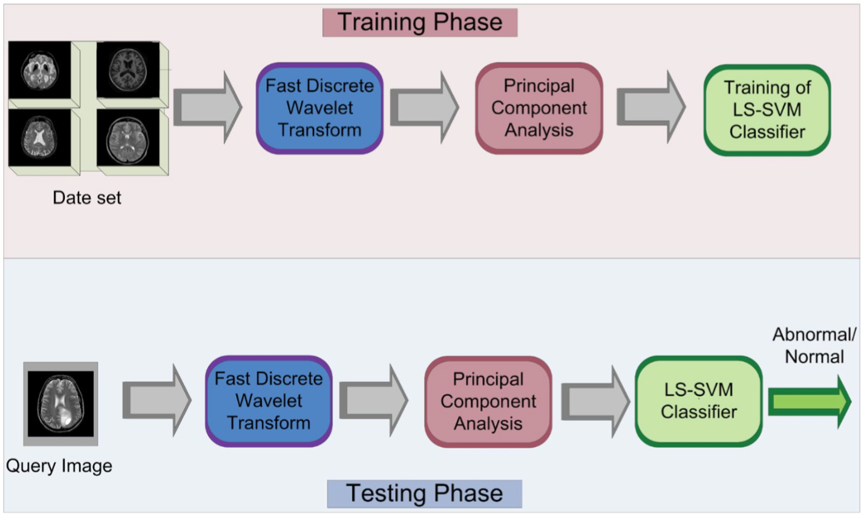

Slide 30
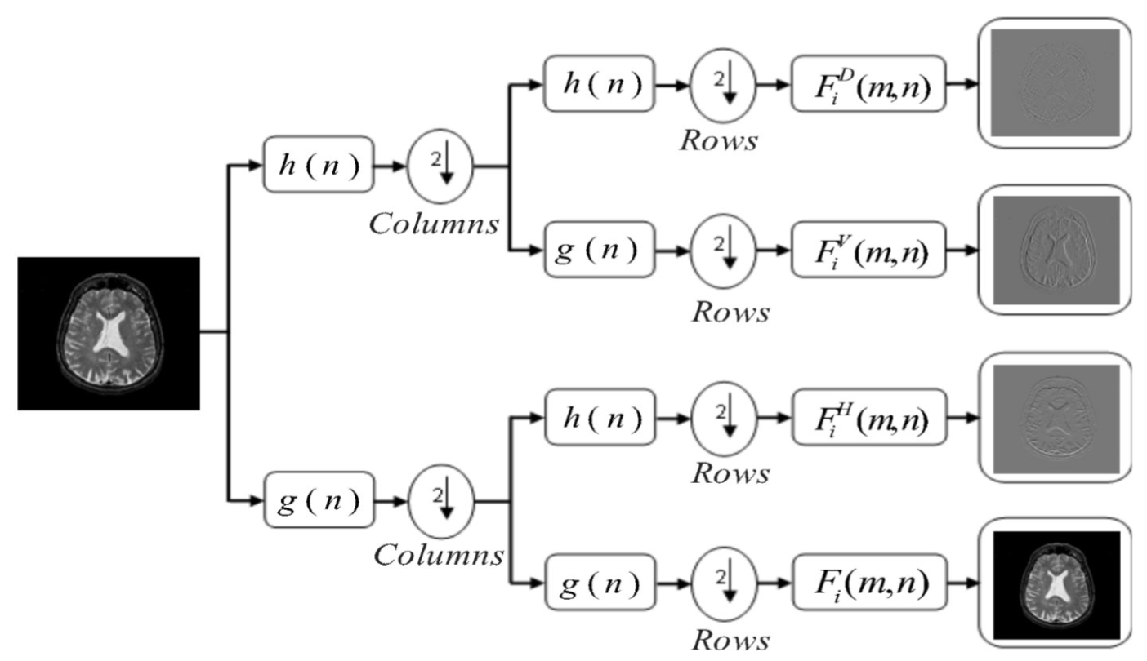

Slide 31
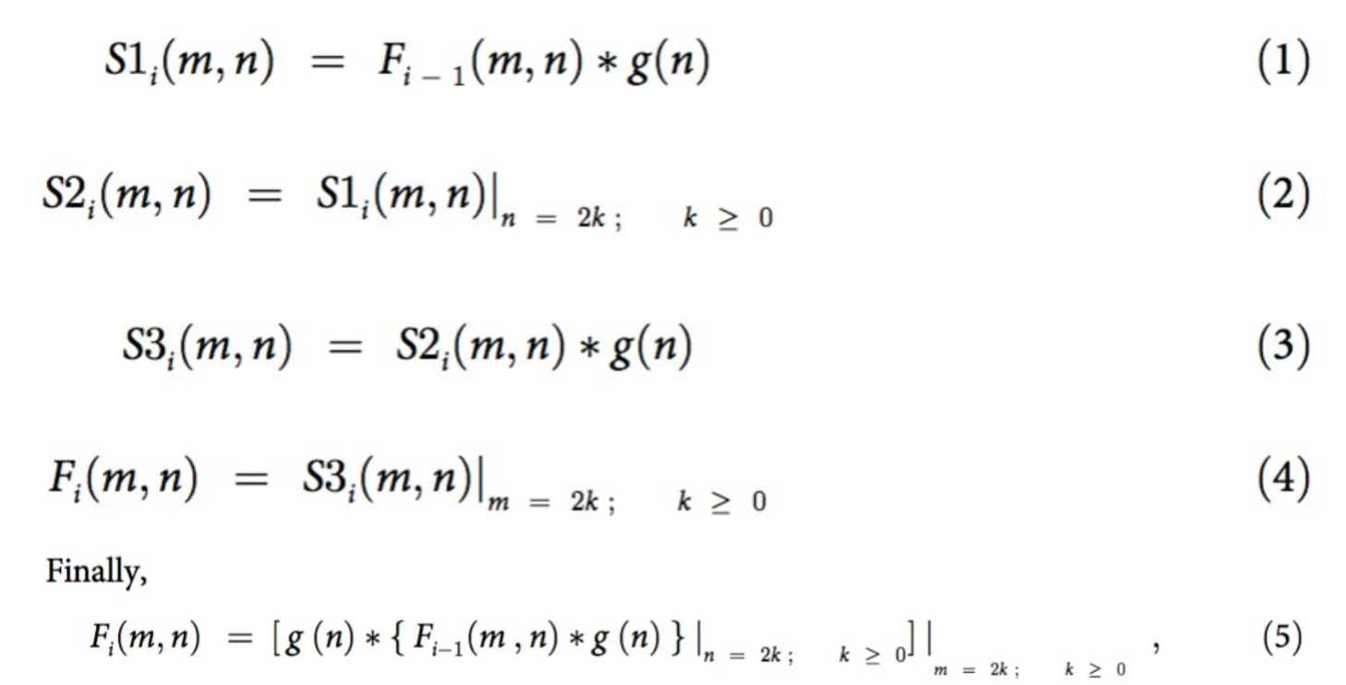
The mathematical function of 2­D fast DWT

Slide 32
A decision support system to manage the supply chain of sugar cane
DSS is used for planning daily operations of sugar chain supply chain
Main component is based on a mixed integer linear programming model
Main purpose is to minimize transportation cost of supply chain of sugar cane ,
Daily sugar cane harvesting and processing, cutting means, road
transport means, like fields, and storage facilities are represented as inputs
The database stores inputs and outputs and it interacts with mathematical model

Slide 33
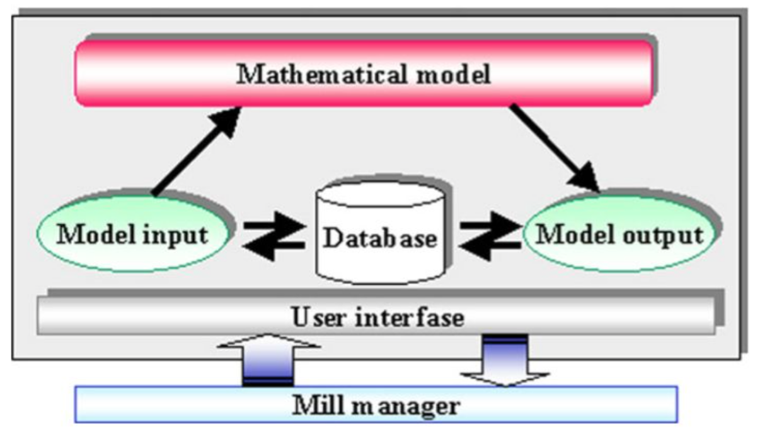
Main structure of the DSS

Slide 34
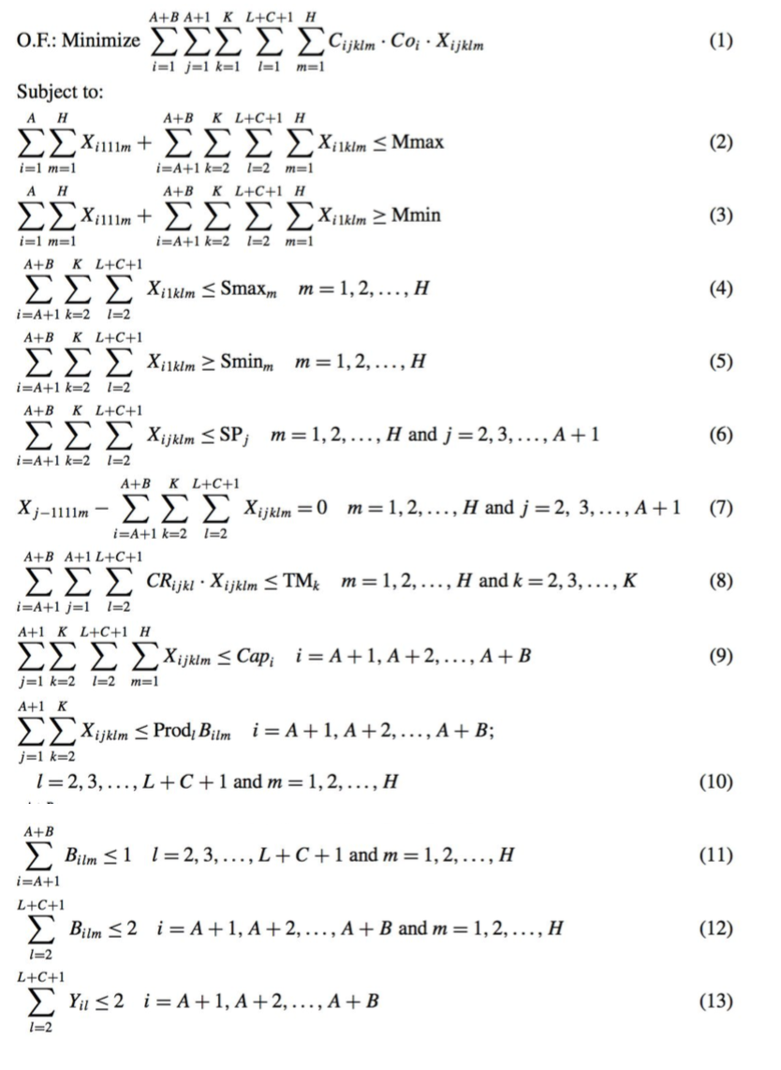

Slide 35
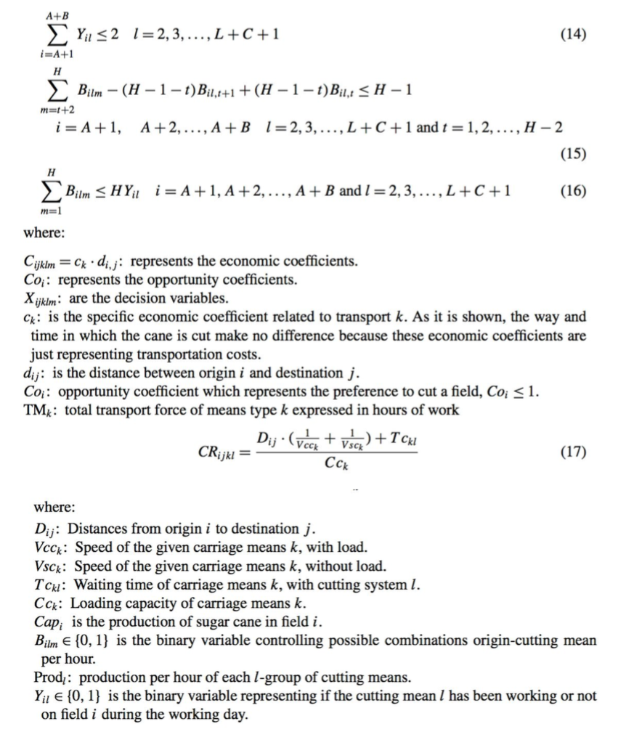

Slide 36
Thank you for listening
ANY QUESTION ?

Slide 37
Resources
Decision Support Systems the Uses, Pros and Cons. (10.11.2015) <http://www.decision­making­confidence.com/decision­support­systems.html>
Types of Decision Support Systems(DSS). Dan Power. (15.11.2015) <http://www.gdrc.org/decision/dss­types.html>
What are the features of a communications­driven DSS? ​Daniel J. Power. (15.11.2015). http://dssresources.com/faq/index.php?action=artikel&id=134
Power, D. Decision Support Systems: Concepts and Resources for Managers, Westport, CT: Quorum/Greenwood, 2002.
Duftschmid, G. & Miksch, S. (2001). Knowledge­based verification of clinical guidelines by detection of anomalies, Artif Intell Med 22: 23–41.
Preece, A. (1998). Building the right system right ­ Evaluating V&V methods in knowledge engineering, Proceedings of the eleventh workshop on Knowledge Acquisition, Modeling and Management (KAW’98), Voyager Inn, Banff, Alberta, Canada.
Power, D., "Is email a good decision support tool?", DSS News, Vol. 7, No. 18, August 27, 2006.
Marek J.Drunzel & Roger R. Flynn (2002). “Decision Support Systems”
Meyer, B. (2008). Seven principles of software testing, IEEE Computer 41(10): 99–101.
Jean­Baptiste Lamy, Anis Ellini, Jérôme Nobécourt, Alain Venot and Jean­Daniel Zucker (2013). Testing Methods for Decision Support Systems
Esteban López­Milán & Lluis M. Plà­Aragonés (2013). New York. A decision support system to manage the supply chain of sugar cane
Muhammad Faisal Siddiqui, Ahmed Wasif Reza, Jeevan Kanesan (2015). An Automated and Intelligent Medical Decision Support System for Brain MRI Scans Classification

